Slide 1

DECODING BOOK SUCCESS ON AMAZON
Presentation By
Guli Aminjonova, Jane Chiriyankandath, Mary Nshikokola & Maria Velazquez

Slide 2

Problem Description
Project Objective: Help new authors understand key factors contributing to book success.
Dataset: Analyzing Amazon Bestselling Books dataset.
Key Focus Areas: Popular genres, influential authors, pricing dynamics, and language trends in book titles.
Benefits for New Authors: Valuable insights for writing, marketing, and publishing strategies to increase chances of success.

Slide 3
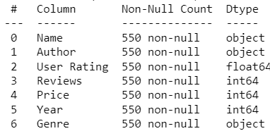
Data Description
Name: Title of the book
Author: Name of the author(s) of the book
User Rating: Average rating given to the book by users on Amazon (on a scale from 0 to 5 stars)
Reviews: Number of customer reviews the book has received on Amazon
Price: Current price of the book on Amazon
Year: Year in which the book was a bestseller on Amazon
Genre: Broad category that the book belongs to (e.g., fiction and nonfiction)

Slide 4
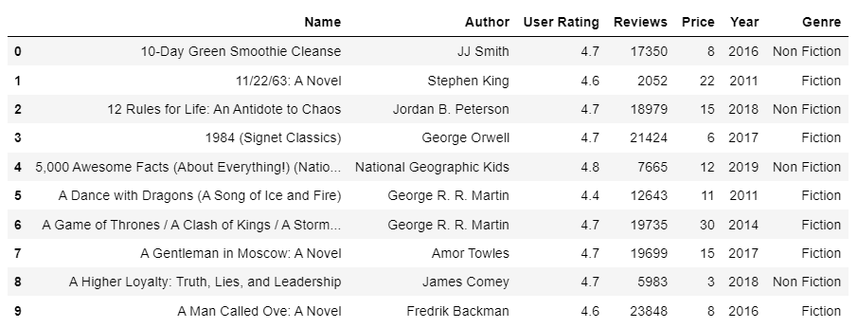
Sneak Peek into the Data

Slide 5
EDA Findings
This dataset contains data from the year 2009 to 2019.
The dataset shows a larger number of non-fiction books than fiction books.
Despite having 550 rows of data, we observe only 351 unique books, indicating that certain books have appeared multiple times in the dataset due to their recurring status as best-selling books.
Some books appear twice as best-sellers in the same year, requiring further investigation for accuracy.
User ratings range from 3.3 to 4.9, with most of the books receiving a rating of 4.8.
Notes:
Mary

Slide 6
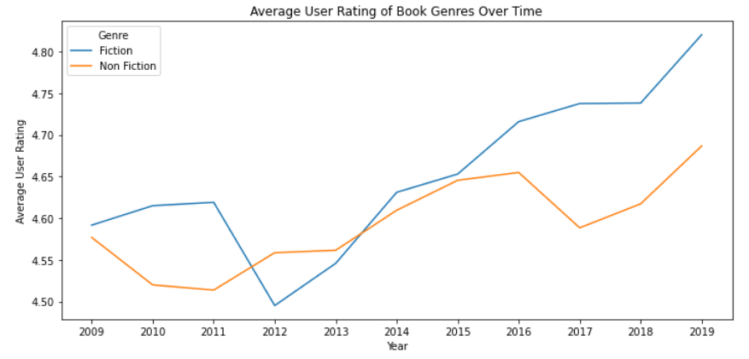
What is the most popular book genre, and how has the popularity of different book genres changed over time?
Research Question 1
Answer: Fiction is the most popular book genre, and its popularity has remained consistently higher than Non-Fiction over time, except for 2012 and 2013.
Notes:
Maria

Slide 7
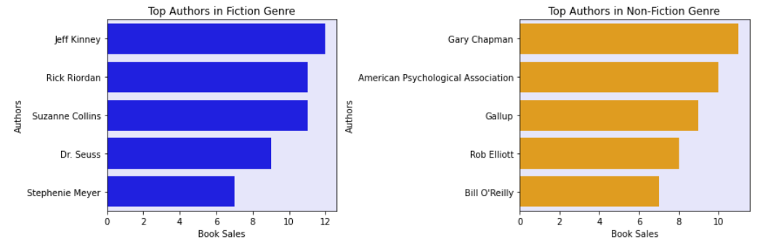
Are there certain authors that consistently appear in the bestselling books list?
Research Question 2
Answer: The author with the most books in the fiction genre is Jeff Kinney, who has contributed different books or series that appear in the dataset. On the other hand, Gary Chapman is the top author in the non-fiction genre because the same book by him appears multiple times, indicating its continued popularity in that category.
Notes:
Maria

Slide 8
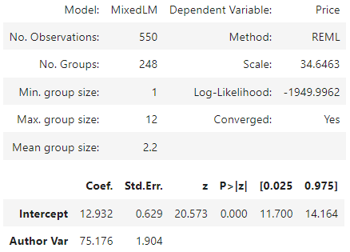
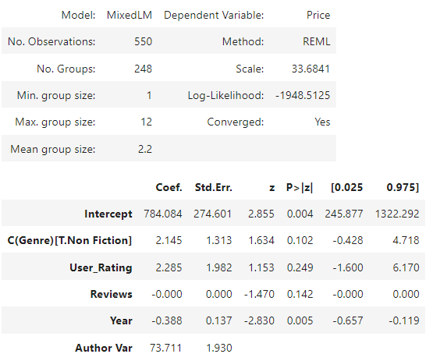
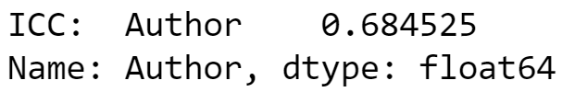
Which variables influence the book price?
Research Question 3
Intercept Only Model (Empty Model):
Random Intercept Model:

Slide 9
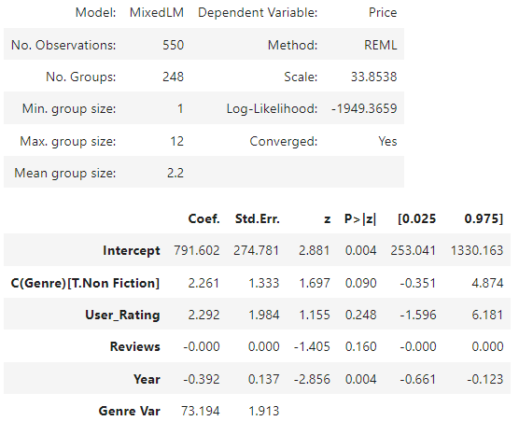
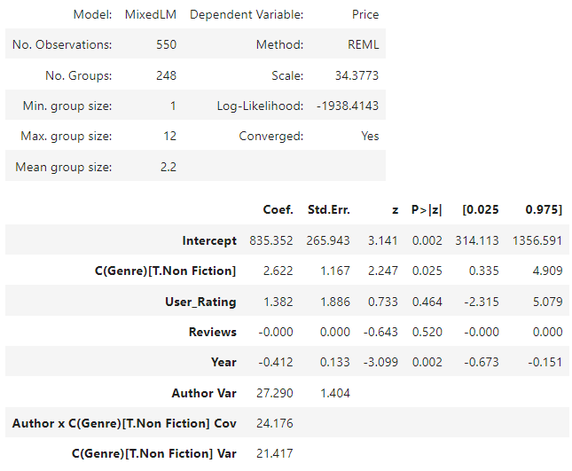
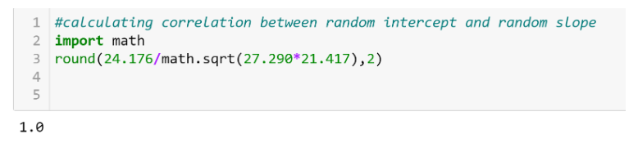
Which variables influence the book price?
Research Question 3
Random Slope Model:
Full Linear Mixed Model:

Slide 10
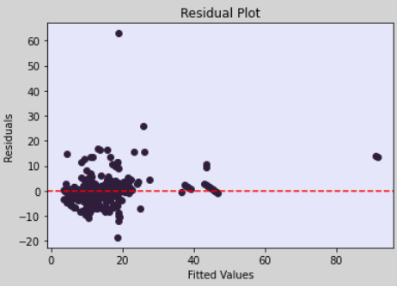
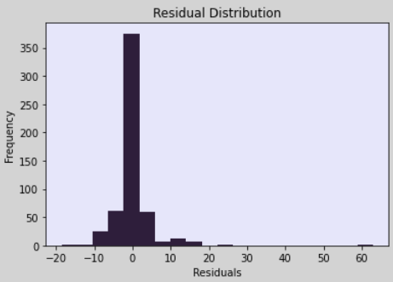
Research Question 3
Which variables influence the book price?
Residual Plot:
Residual Distribution:

Slide 11
Research Question 3
Which variables influence the book price?
Answer:
There is a significant relationship between Genre and Price. For books categorized as "Non Fiction," the model estimates their average Price to be 2.622 units higher than those categorized as "Fiction
The variable Year also has a statistically significant relationship with Price. A one-unit increase in Year is associated with a decrease of 0.412 units in Price.
The estimated variance of the random effect for the Author is 27.290. This captures the variation in Price that is attributed to different authors and not accounted for by the fixed effects.
There is a strong positive correlation between the random slope and random intercept on the model. This suggests that certain authors tend to consistently write books belonging to the “Non-Fiction" genre, while others tend to write books belonging to the "Fiction" genre.

Slide 12
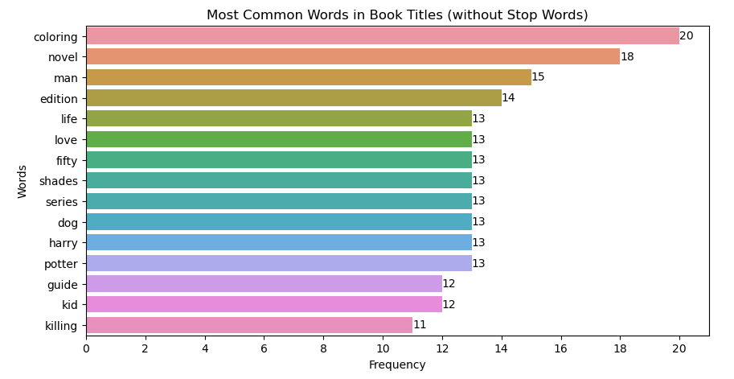
Research Question 4
Part 1: What are the most frequently occurring words in book titles?

Slide 13
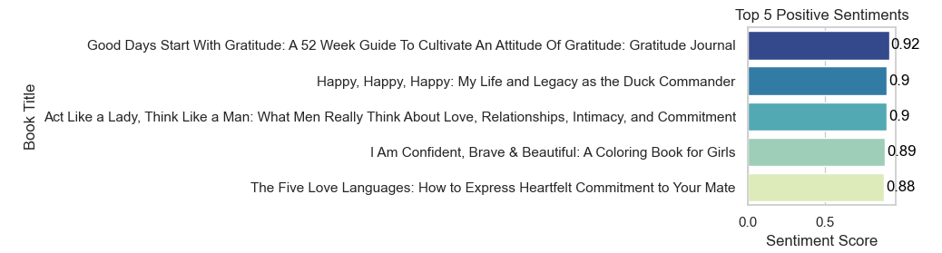
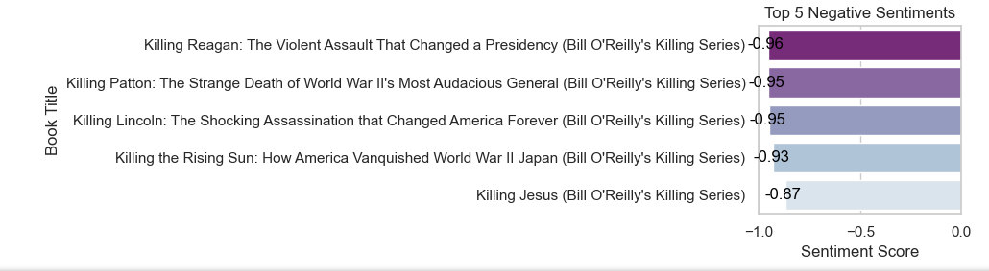
Research Question 4
Part 2: What insights do we gain from sentiment analysis?

Slide 14
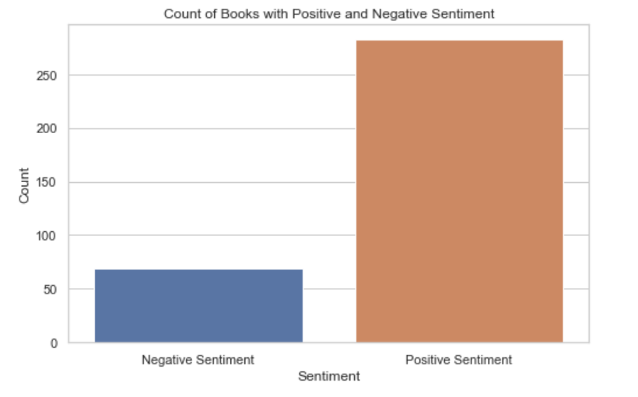
Research Question 4
Part 2: What insights do we gain from sentiment analysis?
Answer: Out of all the analyzed books, 282 received positive compound sentiment scores ranging from 0 to 1, while 69 received negative compound sentiment scores. This indicates that most of the bestselling books during that period focused on positive emotions and themes.

Slide 15

Recommendations
Fiction books tend to receive higher user ratings. Authors should understand their target audience and connect with them and their preferences.
Considering that the year of publication has a significant relationship with pricing, authors should stay informed about current market trends and adjust their pricing strategy accordingly.
Authors should take note of the dominant themes and emotions that emerged from the analysis and incorporate these themes into their storytelling to align with readers' preferences.
Besides these recommendations from the analysis, we suggest authors stay passionate, authentic, and dedicated and continually seek opportunities to grow and connect with their readership.
Notes:
Maria

Slide 16

Conclusion
It is very important to understand the popularity dynamics.
Fiction is the most popular genre based on average user ratings.
The relationship between pricing and genre should be considered: Non-fiction books tend to have higher prices than fiction books.
The year of publication also has a significant negative relationship with price, indicating that older books tend to be priced lower.
The majority of analyzed books received positive sentiment scores, indicating that the top-selling books focused on positive emotions and themes.
Notes:
Mary

